Slide 1
Data Analytics Foundations
Chapter 1 – Hands on Data Analytics for Everyone
北京师范大学-香港浸会大学联合国际学院
United International College

Slide 2
Background
Data Analytics Project Lifecycle
Example of Data Analytics Project
Project Understanding Phase
Data Understanding Phase
Data Format
Data Types
Assignment 1: In-class Essay
Assignment 2: In-class Quiz
Lab: Workflow in KNIME (Data Import Export)
Lab: Excel and CSV tables
APPENDIX: Introduction to KNIME

Slide 3
What is Data Science?
Data science is a multi-disciplinary field that uses scientific methods, processes, algorithms and systems to extract knowledge and insights from structured and unstructured data.
[Wikipedia quoting Dhar 13, Leek 13]
Knowledge discovery in databases (KDD) is the process of (semi-)automatic extraction of knowledge from databases which is valid, previously unknown, and potentially useful.
[Fayyad, Piatetsky-Shapiro & Smyth 96]

Slide 4
What is Data Science? From Data To Knowledge
Data
refer to single instances (single objects, people, events, points in time, etc.)
describe individual properties
are often available in large amounts (databases, archives)
are often easy to collect or to obtain (e.g., scanner cashiers in supermarkets, Internet)
do not allow us to make predictions or forecasts
Knowledge
refers to classes of instances (sets of objects, people, events, points in time, etc.)
describes general patterns, structures, laws, principles, etc.
consists of as few statements as possible
is often difficult and time consuming to find or to obtain (e.g., natural laws, education)
allows us to make predictions and forecasts

Slide 5
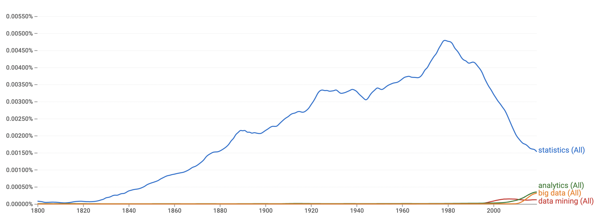
Past and Present: The Era of Statistics (1800-2000)
Source: Google Book Ngram viewer (case insensitive search)
Analytics and big data appearing and increasing around 2010
data mining appears in late 1990s
Statistics reached peak in 1980 and it is decreasing since then.

Slide 6
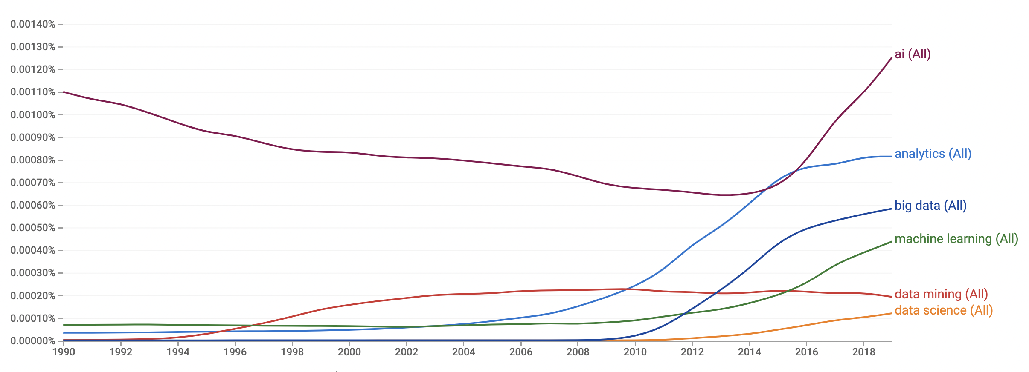
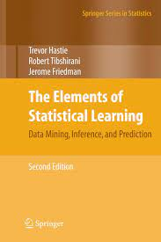


The Present: Data Analytics
Past and Present: Surge of Data Analytics
Data mining surges in 1996
AI re-surges in 2015 after declining
Big Data, analytics, machine learning and data science all surges in between 2008-2015

Slide 7
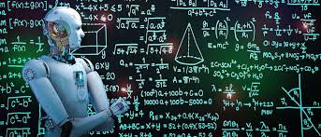
What the future holds?
1900s - Statistics
1960s “Data Mining” is a bad activity (data “dredging” meaning)
1990 - “Data Mining” is good, surges in 1996 and peak in 2003
2010s - Business/Data/Predictive Analytics, Machine Learning and Data Science
2014 - Big Data / Deep Learning
2018 – A.I.
-- 2030 ?
Software engineering
Robotics
Liberal Arts

Slide 8
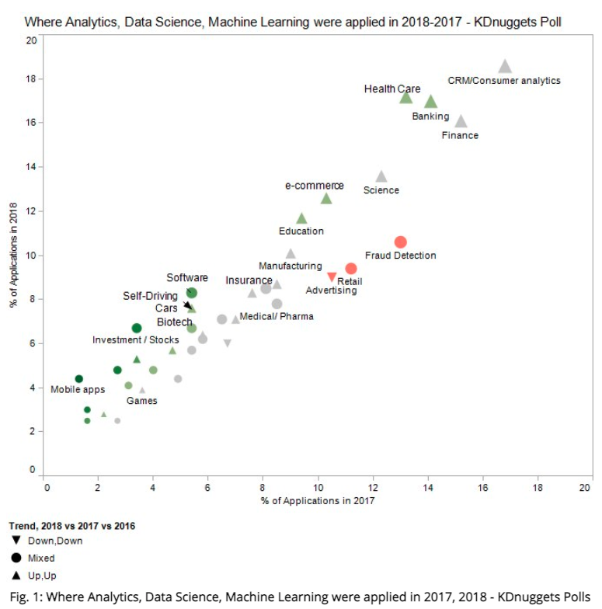
Main Industries for Data Analytics According to Experts
Source: Kdnuggets https://www.kdnuggets.com/2019/03/poll-analytics-data-science-ml-applied-2018.html
Readers of KDnuggets were asked: What are the Industries / Fields where you applied Analytics, Data Science, Machine Learning in 2018?
The top 5 industries were:
CRM/Consumer analytics, 18.6% (number 1 for the last 5 years)
Health care, 17.2% (jump to number 2 from number 4 )
Banking, 17.0%
Finance, 16.1%
Science, 13.6%

Slide 9
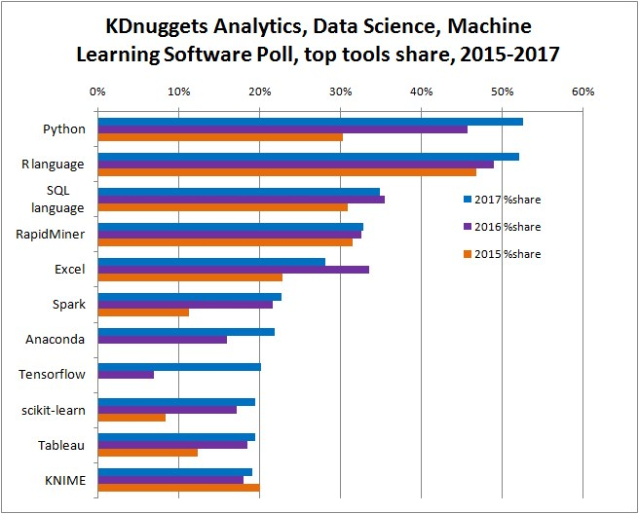
Main Software/Languages for Data Analytics
Source: Kdnuggets https://www.kdnuggets.com/2017/05/poll-analytics-data-science-machine-learning-software-leaders.html

Slide 10
Some Data Science Roles in the Industry
Data Analyst
(Big) Data Engineer
Data Scientist
Machine Learning Researcher
Data Science Manager/Director
Chief Data Officer

Slide 11
Data Science Skills
Database, Coding Skills
Math, Statistics, Machine Learning Knowledge
Domain / Business Expertise

Slide 12
Background
Data Analytics Project Lifecycle
Example of Data Analytics Project
Project Understanding Phase
Data Understanding Phase
Data Format
Data Types
Assignment 1: In-class Essay
Assignment 2: In-class Quiz
Lab: Workflow in KNIME (Data Import Export)
Lab: Excel and CSV tables
APPENDIX: Introduction to KNIME

Slide 13
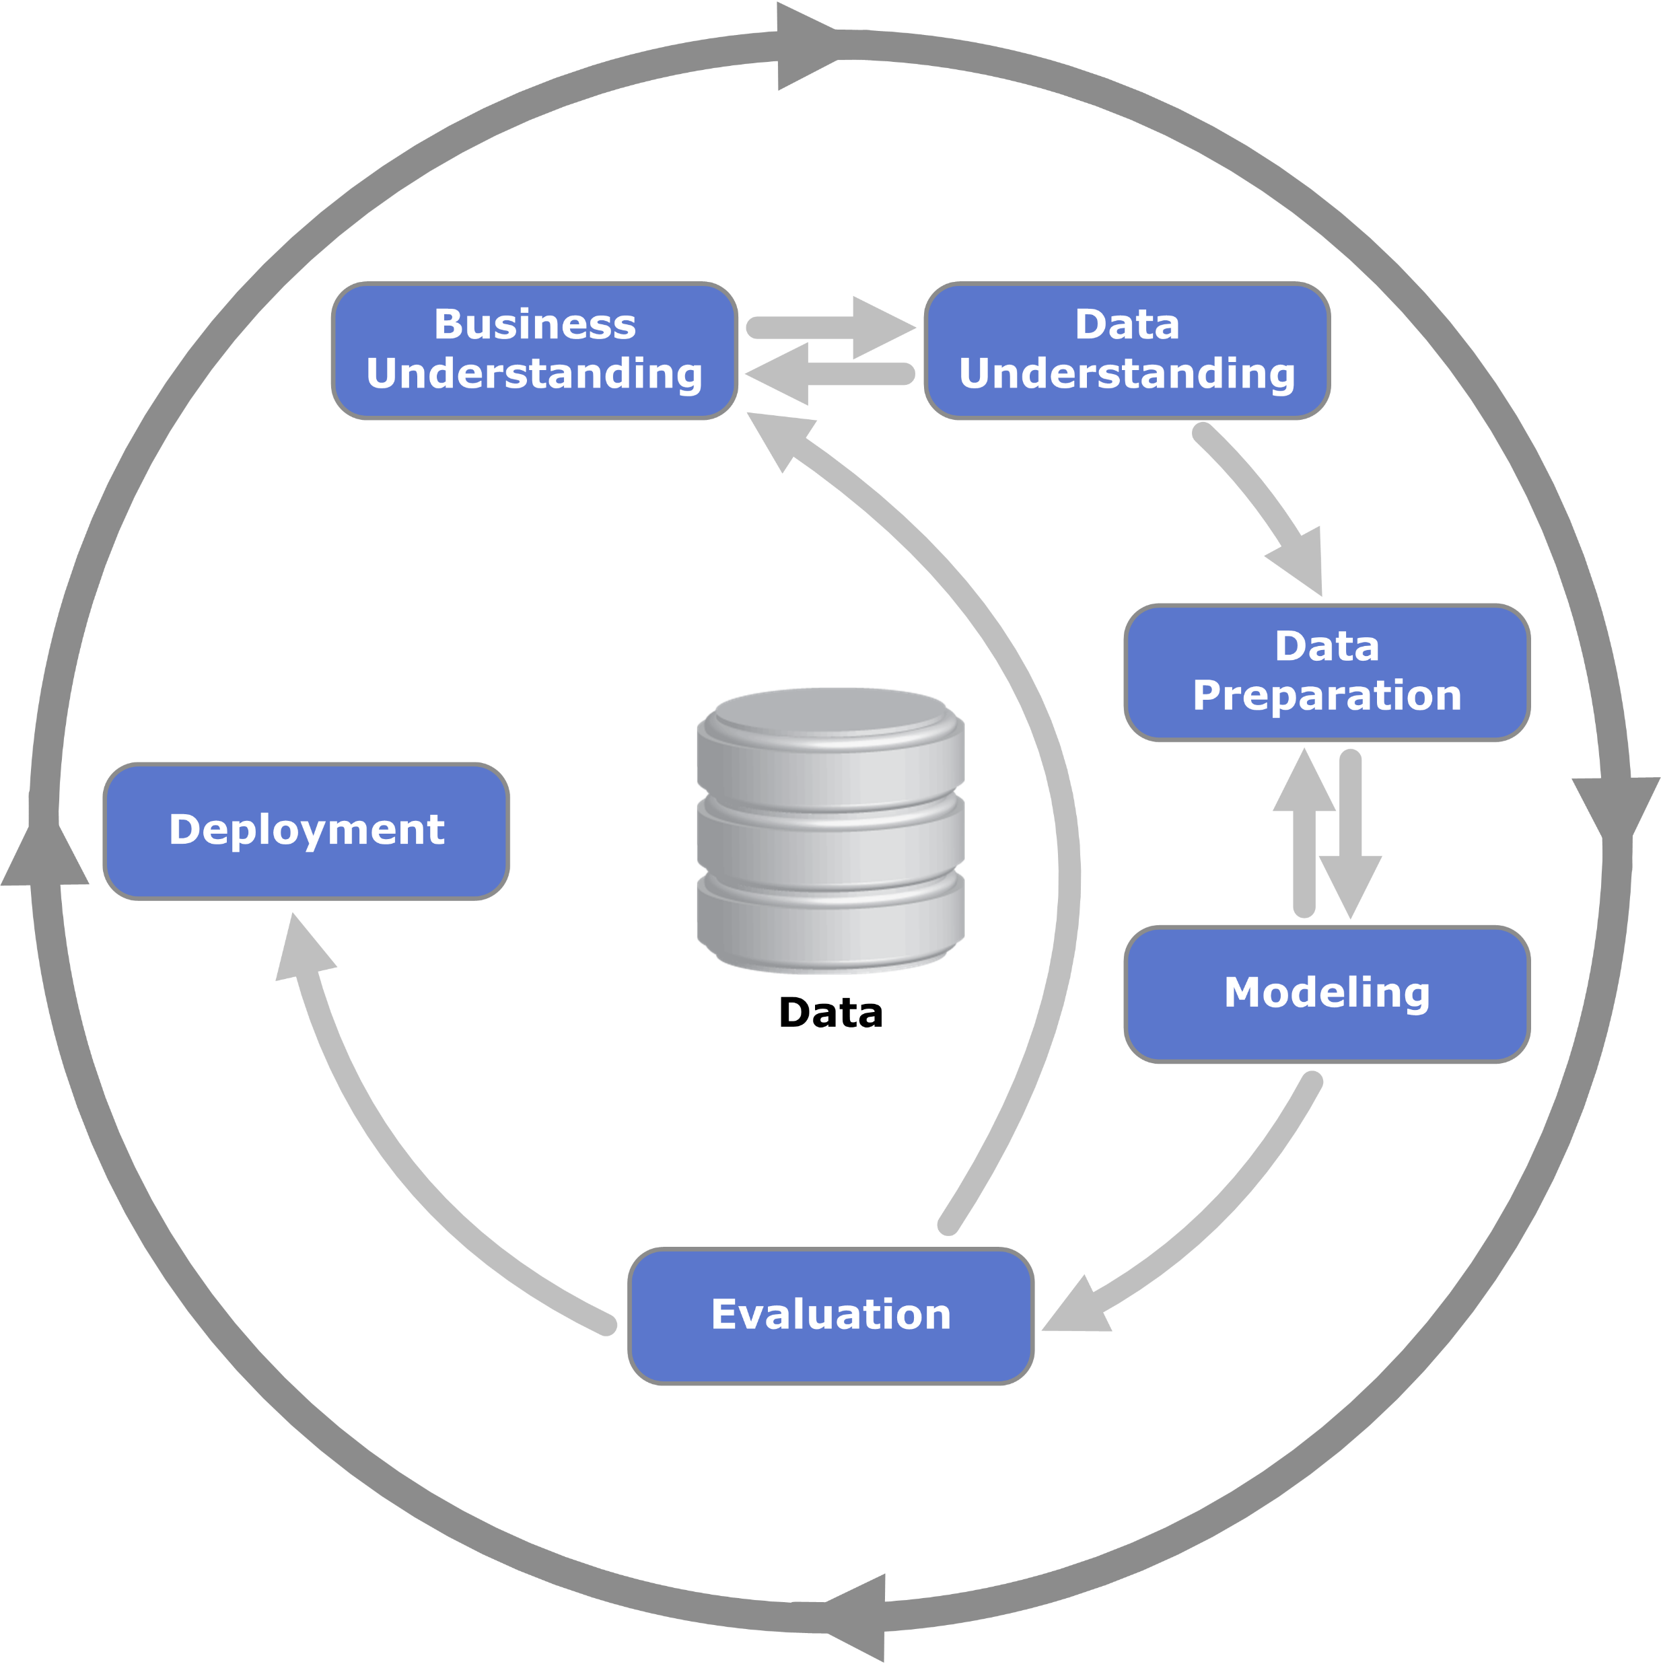
CRoss-Industry Standard Process for Data Mining (CRISP-DM)
CRISP-DM is a European Union standard

Slide 14
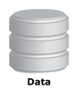
Process Flow of a Data Science Project
It always starts with some data …
Data Preparation
Model Training
Model Optimization
Model Testing
Deployment
Data Manipulation
Data Blending
Missing Values Handling
Feature Generation
Dimensionality Reduction
Feature Selection
Outlier Removal
Normalization
Partitioning
…
Model Training
Bag of Models
Model Selection
Ensemble Models
Own Ensemble Model
External Models
Import Existing Models
Model Factory
…
Parameter Tuning
Parameter Optimization
Regularization
Model Size
No. Iterations
…
Performance Measures
Accuracy
ROC Curve
Cross-Validation
…
Files & DBs
Dashboards
REST API
SQL Code Export
Reporting
…

Slide 15
Background
Data Analytics Project Lifecycle
Example of Data Analytics Project
Project Understanding Phase
Data Understanding Phase
Data Format
Data Types
Assignment 1: In-class Essay
Assignment 2: In-class Quiz
Lab: Workflow in KNIME (Data Import Export)
Lab: Excel and CSV tables
APPENDIX: Introduction to KNIME

Slide 16



Example 1: Customer Segmentation
Business question: Which groups of customers am I serving?
CRM System
Data about your customer
Demographics
Behavior
Revenues
Churn Prediction
Upselling Likelihood
Product Propensity /NBO
Campaign Management
Customer Segmentation
…
Model

Slide 17
Example 1
Dataset from a hypothetical supermarket chain
Customers
Products
Purchases
Three tasks
Divide customers into different groups according to their purchase behaviour
Identify connections between products to implement cross-selling campaigns
Helping design a marketing campaign to increase purchases
Two approaches
Naive approach lead by common sense
Sound approach using data analytics techniques

Slide 18
Example 1: Data Understanding and Pattern Finding
A Naive Approach
Compute the age of each customer
Run an algorithm (cluster analysis) to group customers based on their age and expenditure
No interesting relations highlighted in this analysis
Cluster ID | Age (Cluster Average) | Total Purchase (Cluster Average)
1 | 46.5 | € 1,922.07
2 | 39.4 | € 11,162.20
3 | 39.1 | € 7,279.59
4 | 46.3 | € 419.23
5 | 39.0 | € 4,459.30

Slide 19
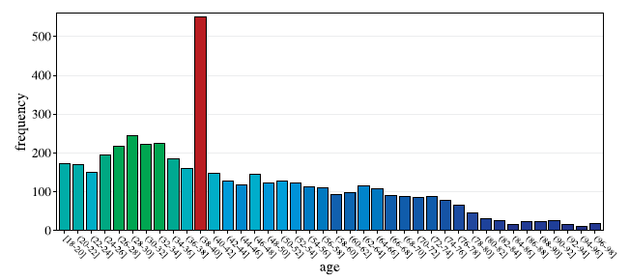
Example 1: Data Understanding and Pattern Finding
Sound Approach – Check Data
Check customer names, employment if match expectations
Check and add constraints to numeric attributes (e.g. Age must be between 18-100)
Look for misleading information (e.g. a missing birthdate was automatically set by default set to 1970, these cases must be handled)
Use meaningful measures
Use average basket price as estimator for the value of a customer
Use average number of purchases per month as further estimator
Apply the clustering algorithm
Apply normalization of measures to average magnitudes and compare across different features
Cluster | Age | Avg. cart price | Avg. purchase/month
1 | 75.3 | € 19.- | 5.6
2 | 42.1 | € 78.- | 7.8
3 | 38.1 | € 112.- | 9.3
4 | 30.6 | € 16.- | 4.8
5 | 44.7 | € 45.- | 3.7

Slide 20
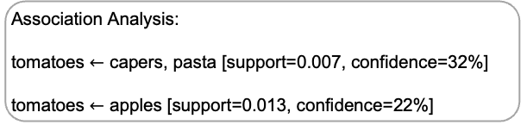
Example 1: Data Understanding and Pattern Finding
Cluster | Age | Avg. cart price | Avg. purchase/month
1 | 75.3 | $ 19.- | 5.6
2 | 42.1 | $ 78.- | 7.8
3 | 38.1 | $ 112.- | 9.3
4 | 30.6 | $ 16.- | 4.8
5 | 44.7 | $ 45.- | 3.7
Interpretation:
Cluster (#1) of older customers have a relatively small average basket price
Cluster (#4) of younger shoppers also purchasing smaller baskets.
The middle-aged group varies wildly in price, however.
Assumption about family status:
People with families will likely buy more products and hence combine more products into more expensive baskets, which seems to explain the difference between clusters #2/#3 and cluster #5.
Further Analysis:
Consider product categories
Rules match with well-known facts
Monitor combinations on regular basis
Association Analysis:
tomatoes $←$ capers, pasta [support=0.007, confidence=32%]
tomatoes $←$ apples [support=0.013, confidence=22%]

Slide 21
Example 1: Targeted Marketing from Customer Segmentation
After the analysis, the data analyst, marketing and campaign specialists meet to develop strategies to foster the customer groups which bring in the largest chunk of revenue and develop the ones which seem to be underrepresented
Discount program targeting the basket size of customers. For example:
discount of 1$ on food purchase targeting cluster #1
discount of 10$ on electronics purchase targeting cluster #3
Predict the need and recommend product to its existing customers. For example recommend capers and pasta for those who purchased tomato

Slide 22
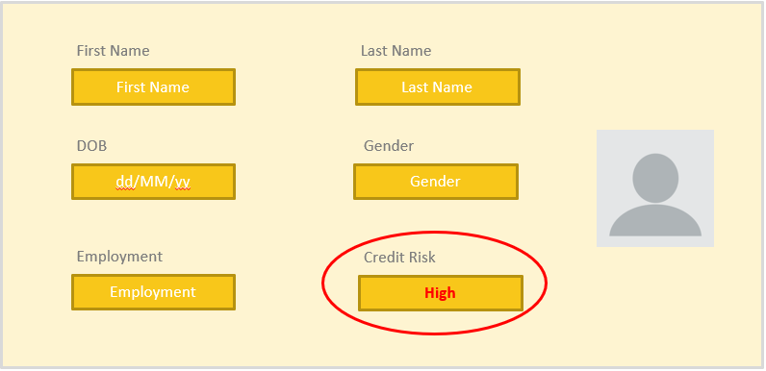
Example 2: Risk Assessment
Business question: Is this person going to repay the loan?
Customer History
Risk Prognosis
Oct 2015
Cvrerhfd
Vdsyh
dfgh
ddgd
Oct 2015
Cvrerhfd
Vdsyh
dfgh
ddgd
High Risk
Low Risk
High Risk
Very High Risk
Very Low Risk
Medium Risk
…
Nov 2016
Cvrerhfd
Vdsyh
dfgh
ddgd
Nov 2016
Cvrerhfd
Vdsyh
dfgh
ddgd
Oct 2015
Cvrerhfd
Vdsyh
dfgh
ddgd
Jun 2017
Cvrerhfd
Vdsyh
dfgh
ddgd
Nov 2016
Cvrerhfd
Vdsyh
dfgh
ddgd
Jun 2017
Cvrerhfd
Vdsyh
dfgh
ddgd
Apr 2018
Cvrerhfd
Vdsyh
dfgh
ddgd
Apr 2018
Cvrerhfd
Vdsyh
dfgh
ddgd
Oct 2015
Cvrerhfd
Vdsyh
dfgh
ddgd
Jun 2017
Cvrerhfd
Vdsyh
dfgh
ddgd
Nov 2016
Cvrerhfd
Vdsyh
dfgh
ddgd
Feb 2019
Cvrerhfd
Vdsyh
dfgh
ddgd
Feb 2019
Cvrerhfd
Vdsyh
dfgh
ddgd
Apr 2018
Cvrerhfd
Vdsyh
dfgh
ddgd
Feb 2019
Cvrerhfd
Vdsyh
dfgh
ddgd
Jun 2017
Cvrerhfd
Vdsyh
dfgh
ddgd
Apr 2018
Cvrerhfd
Vdsyh
dfgh
ddgd
Feb 2019
Cvrerhfd
Vdsyh
dfgh
ddgd
Model

Slide 23
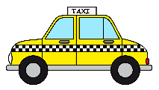
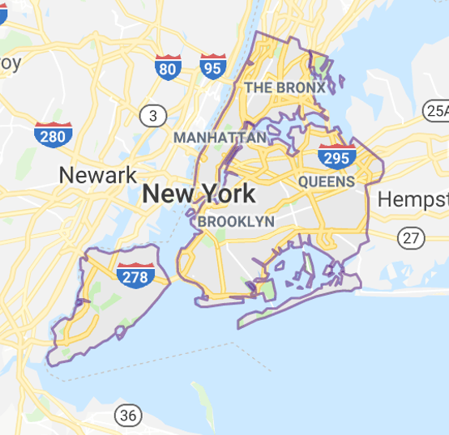
Example 3: Demand Prediction
Business questions:
How many taxis do I need in NYC on Wednesday at noon?
Or how many kW will be required tomorrow at 6am in London?
Or how many customers will come tonight to my restaurant?
Model

Slide 24



Example 4: Recommendation Engines / Market Basket Analysis
Business question: People who bought this item were often interested in this other items.
Recommendation
IF
➔
Model

Slide 25

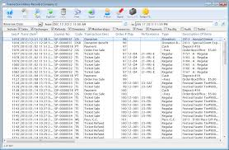
Example 5: Fraud Detection
Business question: Is this transaction legitimate or is it a fraud?
Suspicious Transaction
Transactions
Trx 1
Trx 2
Trx 3
Trx 4
Trx 5
Trx 6
…
Model

Slide 26

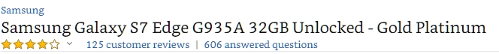
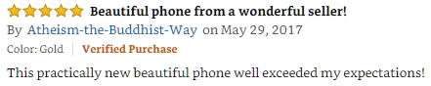



Example 6: Sentiment Analysis
Business question: how can I know what people are thinking?

Slide 27
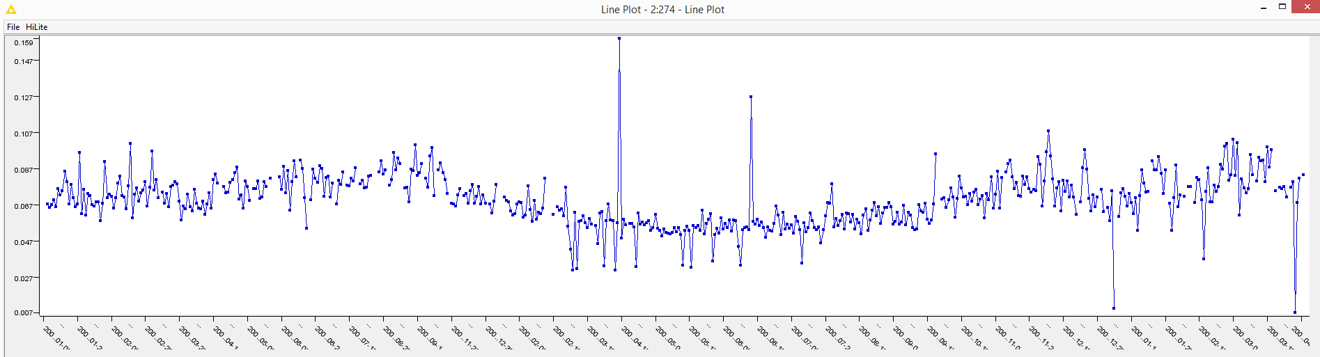
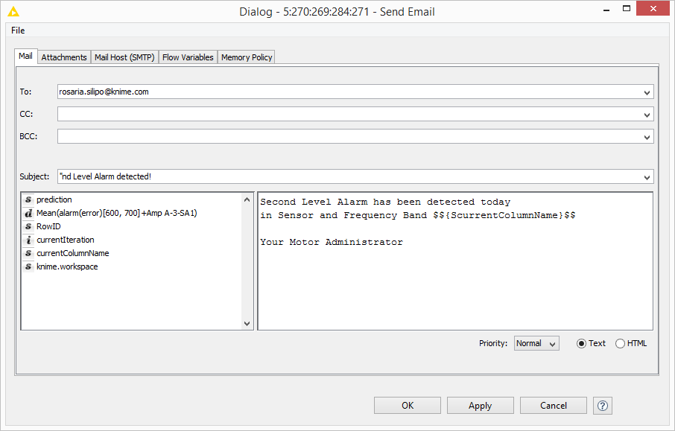
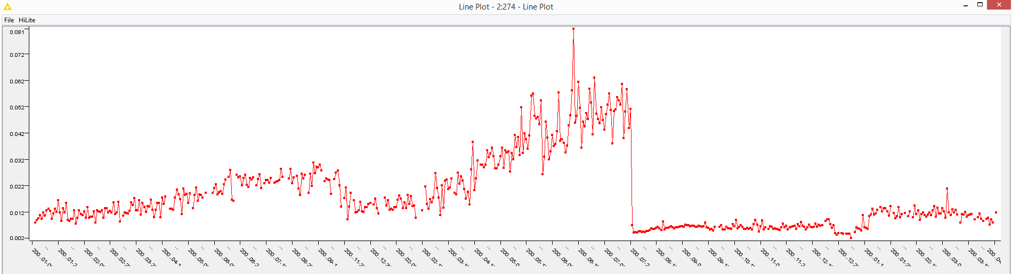


Example 7: Anomaly Detection
Business question: Can I predicting mechanical failure before it happens?
Only some Spectral Time Series show the break down
A1-SV3 [0, 100] Hz
31 August 2007
Predictive Maintenance
Breaking point
July 21, 2008
A1-SV3 [500, 600] Hz
Training Set
via REST

Slide 28
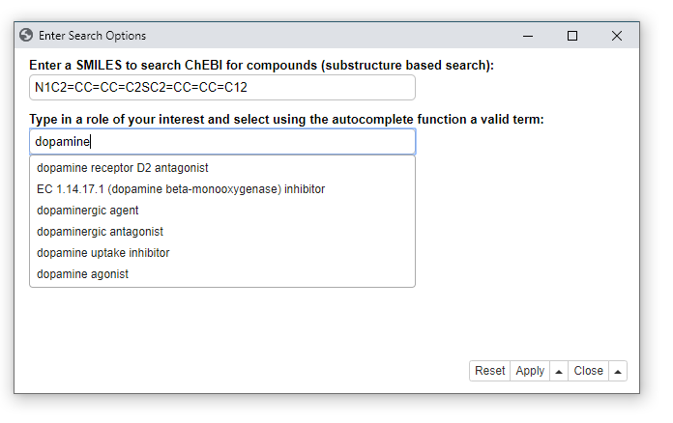
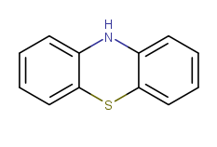
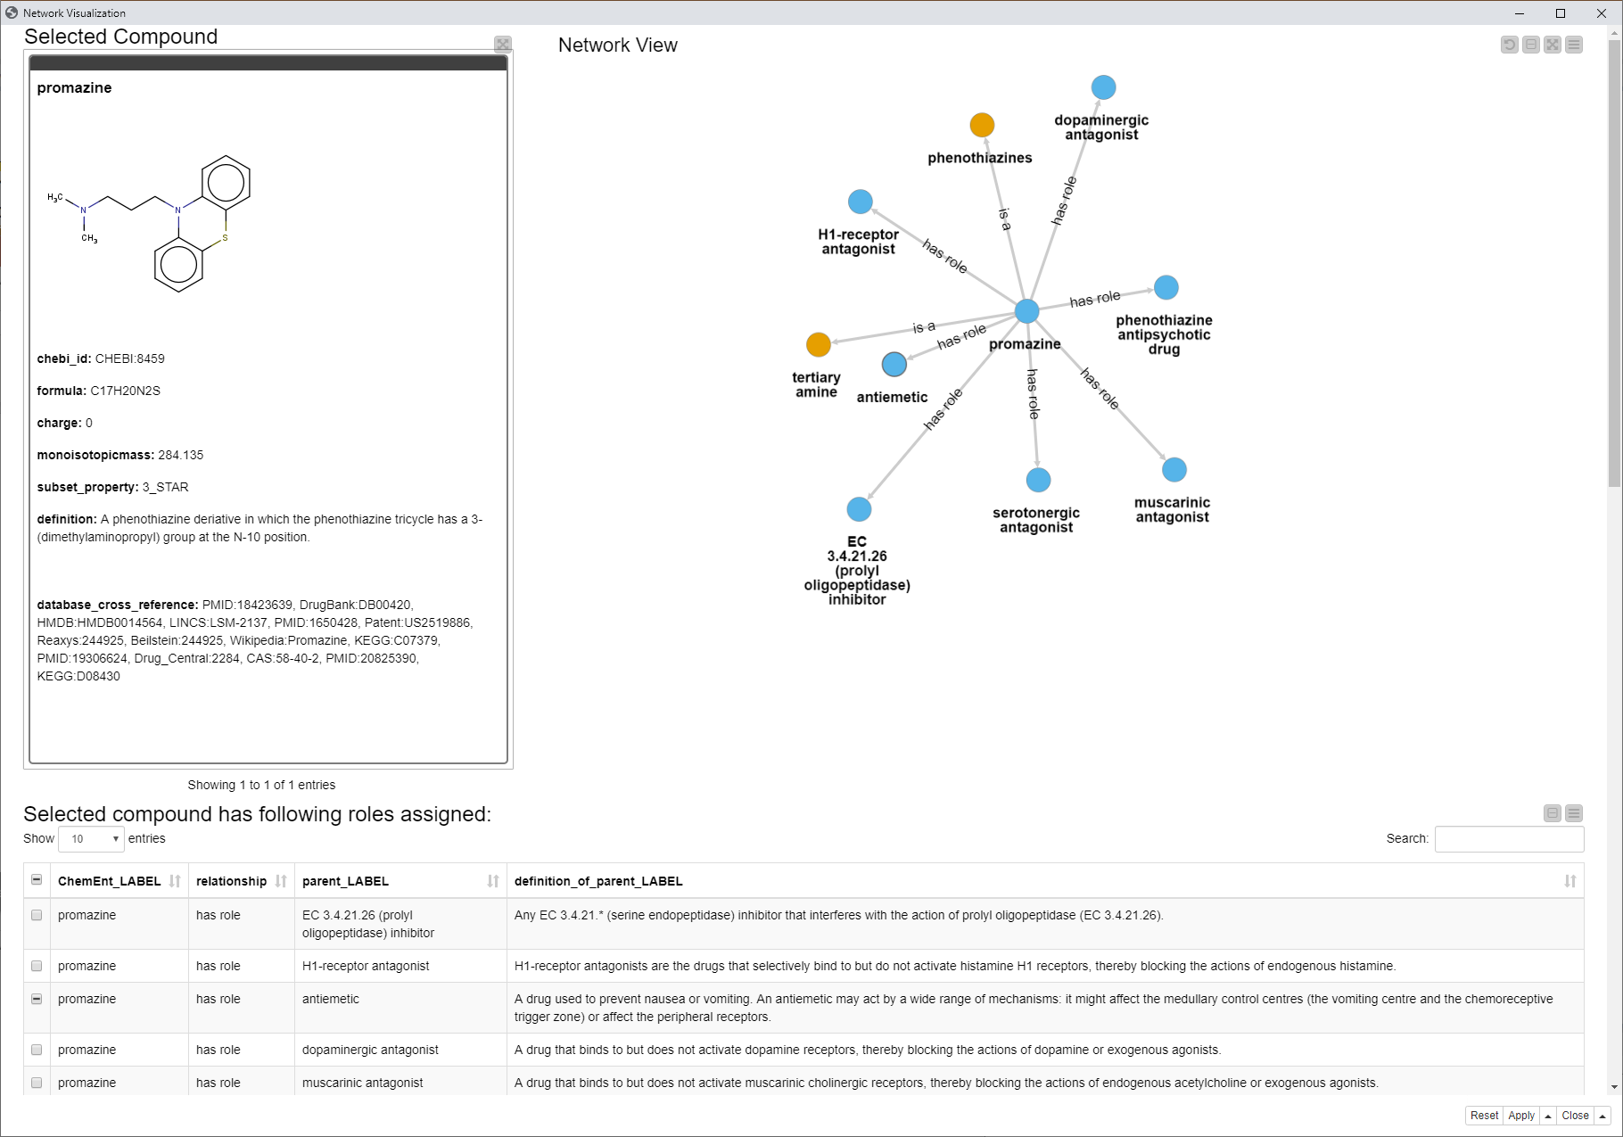
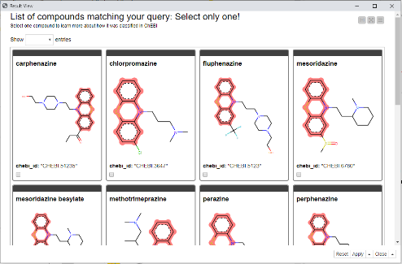
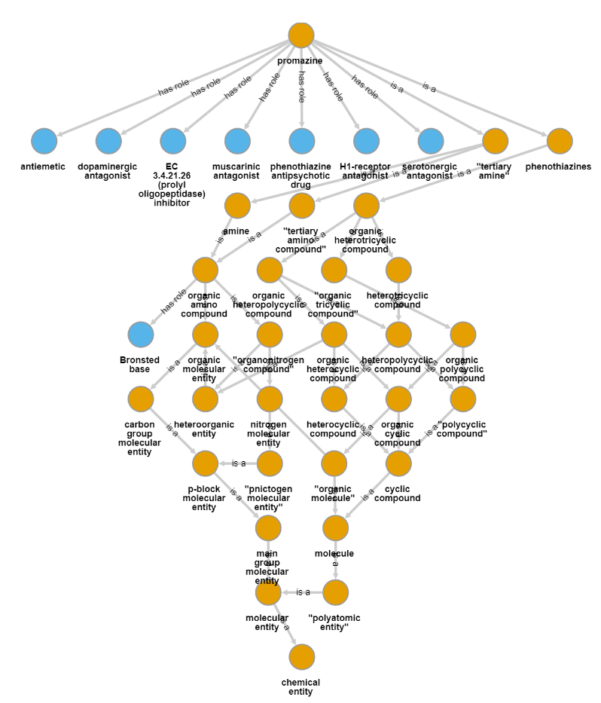

Example 8: Compound Search (Analytical Chemistry)
Questions: Improve product quality, material yield and properties of the material
Are there other compounds having this
substructure and being a dopaminergic antagonist?

Slide 29
Background
Data Analytics Project Lifecycle
Example of Data Analytics Project
Project Understanding Phase
Data Understanding Phase
Data Format
Data Types
Assignment 1: In-class Essay
Assignment 2: In-class Quiz
Lab: Workflow in KNIME (Data Import Export)
Lab: Excel and CSV tables
APPENDIX: Introduction to KNIME

Slide 30
Determine the Project Objective
What is the primary objective?
What are the criteria for success?
Difficulty: The project owner & the analyst speak different languages

Slide 31
Determine the Project Objective
Example:
Objective | Increase revenues (per campaign and/or per customer) in direct mailing campaigns by personalized offer and individual customer selection
Deliverable | Software that automatically selects a specified number of customers from the database to whom the mailing shall be sent, runtime max. half-day for database of current size
Success criteria | Improve order rate by 5% or total revenues by 5%, measured within 4 weeks after mailing was sent, compared to rate of last 3 mailings
Once the solution is identified
Explore advantages & disadvantages
Is the goal
Precise enough?
Actionable?

Slide 32
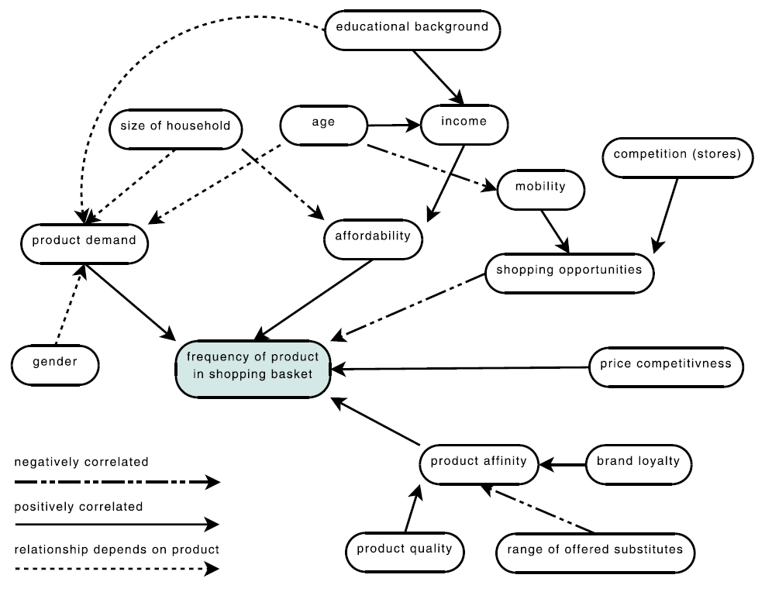
Cognitive Maps
Sketching tool:
Beliefs
Experiences
Known factors
How factors influence each other

Slide 33
Cognitive Maps
How often will a certain product be found in a basket?
Directly influenced by factors around it
E.g., affordability
Indirectly influenced by other factors
E.g., size of household
Postive or negative correlation

Slide 34
Assess the Situation
Will this be a successful data analysis project?
Examine the following:
Requirements and constraints
Model requirements (e.g., explanatory model)
Ethical, political, and legal issues (e.g., must exclude gender, race, and/or age)
Technical constrains
Assumptions
Representativeness (the sample represents the whole population)
Informativeness (influencing factors should be included in the model)
Good data quality
Presence of external factors

Slide 35
Determine Analysis Goals
Select models and techniques with the following properties
Interpretability
The model can be understood / interpreted
Reproducibility / stability
Similar model performance every time the analysis is carried out
Model flexibility / adequacy
The model can adapt to more complicated situations
Runtime
Strict runtime requirements may limit computationally intensive approaches
Interestingness / use of expert knowledge
Experts may already know the findings from the analysis

Slide 36
Background
Data Analytics Project Lifecycle
Example of Data Analytics Project
Project Understanding Phase
Data Understanding Phase
Data Format
Data Types
Assignment 1: In-class Essay
Assignment 2: In-class Quiz
Lab: Workflow in KNIME (Data Import Export)
Lab: Excel and CSV tables
APPENDIX: Introduction to KNIME

Slide 37
Problems with Data and Data Cleaning
Getting the data is not always easy:
Different resources: flat files, different databases, excel spreadsheets, ...
Integration is cumbersome: Missing/not unique IDs, wrong entries, ...
Sometimes also privacy concerns (not all data in one location)
Data needs to be transformed:
Type conversions
Missing value correction/clean up/imputation
Generation of new values (e.g. convert year of birth into age)

Slide 38
Problems with Data and Data Cleaning
In Example 1 we have 3 files:
customers,
products,
shopping baskets.
Can we load these file and create a new attribute “age”?
Can we find out:
how often each customer went shopping
how much (s)he bought together (and on average)

Slide 39
Problems with Data and Data Cleaning
Database issues
More details regarding pre-processing later:
Normalization
Binning
Feature (and Data!) Reduction
...
The 80% Rule
Over 80% of data analysts’ time is spent on loading and cleaning data.

Slide 40
Data Understanding
Goal of the Data Understanding phase
Gain general insights about the data that will potentially be helpful for the further steps in the data analysis process
Reasons
Never trust any data as long as you have not carried out some simple plausibility checks.
Results
At the end of the data understanding phase, we know much better whether the assumptions we made during the project understanding phase concerning representativeness, informativeness, data quality, and the presence or absence of external factors are justified

Slide 41

Data Quality
Garbage in, garbage out
Data quality refers to how well the data fit their intended use
There are various data quality dimensions
Accuracy
Completeness
Unbalanced Data
Timeliness

Slide 42
Accuracy
Accuracy is defined as the closeness between the value in the data and the true value.
Syntactic
The value might not be correct but it belongs at least to the domain of the corresponding attribute
Easy to spot: verify values lying in the domain
Semantic
The value might be in the domain of the corresponding attribute, but it is not correct
Hard or impossible to spot: double check with other sources or check “business rules”
e.g. “female” for the attribute Gender and “-15” for the attribute Weight violate the syntactic accuracy
e.g. “2090” for the attribute YearOfBirth is (at least at the moment) surely incorrect, therefore violates the semantic accuracy

